Slide 1
Everything Everywhere AI at Once
Gert‘s Birthday Workshop, 9.-10.1.2025
A Topsy-Turvy and Contradictory Ride To And Fro AI and Down-to-Earth Software Engineering
Ralph Debusmann (Migros-Genossenschafts-Bund, Zürich)
matthias.debusmann@gmail.com

Slide 2



Agenda
How It All Began: My PhD thesis supervised by Gert – and why it could still matter
Down-to-Earth Software Engineering: From Scala to Data Streaming and Streaming Databases
Back to AI? A New Search Engine that puts Human Intelligence first

Slide 3
1. How It All Began

Slide 4
1. How It All Began
Studies of Computational Linguistics in Saarbrücken (1995-2001)
Found out about a still utterly ingenious idea by Denys Duchier (1999)
He utilized Constraint Programming, usually used for scheduling like FriarTuck etc. to model natural language
With a grammatical framework that was, at that time, pretty much out of fashion – Dependency Grammar
I was intrigued.

Slide 5
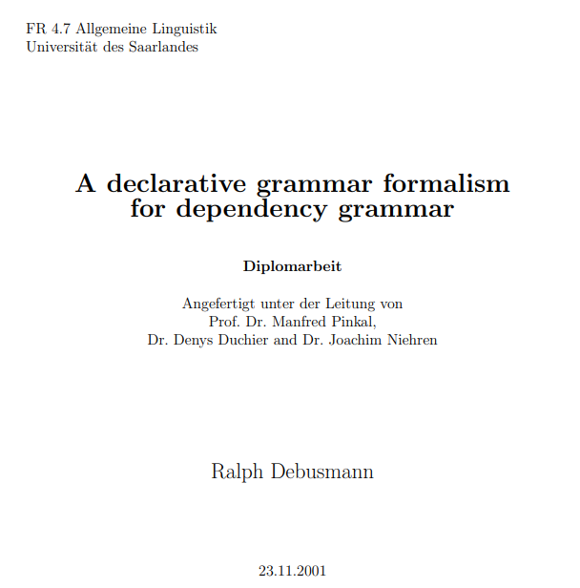
Topological Dependency Grammar (TDG)
From his ideas, we developed, together with Joachim Niehren, a new grammar formalism for natural language syntax: Topological Dependency Grammar (TDG) (Duchier/Debusmann 2001)
Diploma thesis (2001)

Slide 6
How Does It Work?
Denys‘ idea: Regard the syntactic analysis of natural language as a graph configuration problem
Formulated as a Constraint Satisfaction Problem (CSP) in terms of Finite Domain (FD) and Finite Set (FS) constraints (Christian Schulte)
...and implemented in Mozart-Oz

Slide 7
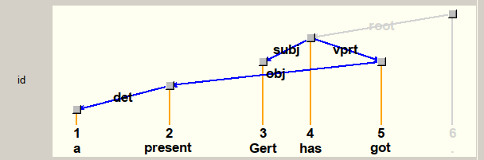
An Example
In TDG, Each word corresponds to a node in a labeled dependency graph, word order yet unconstrained
Syntactic Analysis of the utterance “A present Gert has got“:

Slide 8
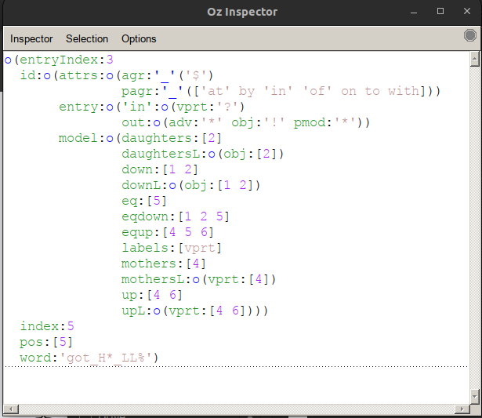
CSP
In the formulation of the CSP, each node is associated with a number of FD and FS variables, e.g.:
The node itself (“index“, “eq“)
Daughters
Mothers
Transitive daughters (“down“)
The node itself + its transitive daughters (“eqdown“)
...

Slide 9
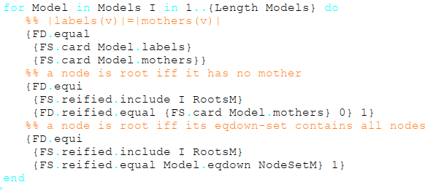
Well-formedness Conditions
We posit the well-formedness conditions of the dependency graphs as constraints on the FD and FS variables:
Globally (e.g. treeness)
Locally/lexically (e.g. valency)
Example (Treeness):

Slide 10
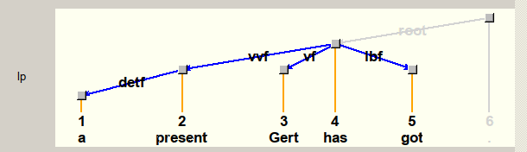
Constrain Word Order
We introduced a second dependency graph to state word order constraints, based on a linguistic theory from the 19th century (Topological Fields):

Slide 11
From Topological to Extensible Dependency Grammar
I was lucky to get the opportunity to get a scholarship (European Graduate College) to continue our work on this idea in my PhD
Result: Extensible Dependency Grammar (XDG)
Supervisors:
Gert (Saarbrücken)
Mark Steedman (Edinburgh University)
...and, before they left Saarbrücken:
Denys Duchier
Joachim Niehren
Exotic topic for the PS Lab ;-)

Slide 12
Extensible Dependency Grammar (XDG)
XDG took TDG several steps further
Models arbitrary many dimensions of dependency multigraphs – not only syntactic structure, but also semantics (predicate-argument structure, scope), prosody and information structure
Here is an example...

Slide 13
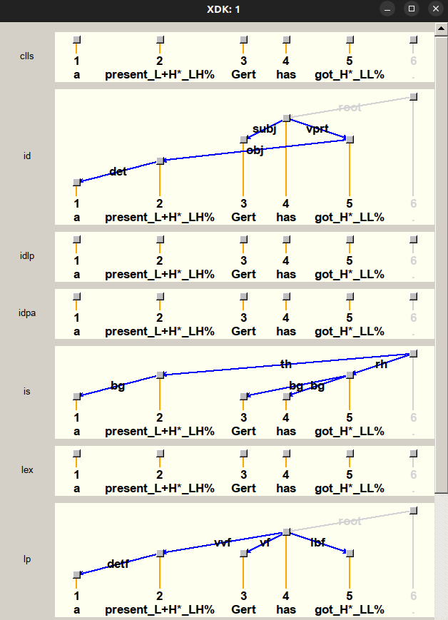
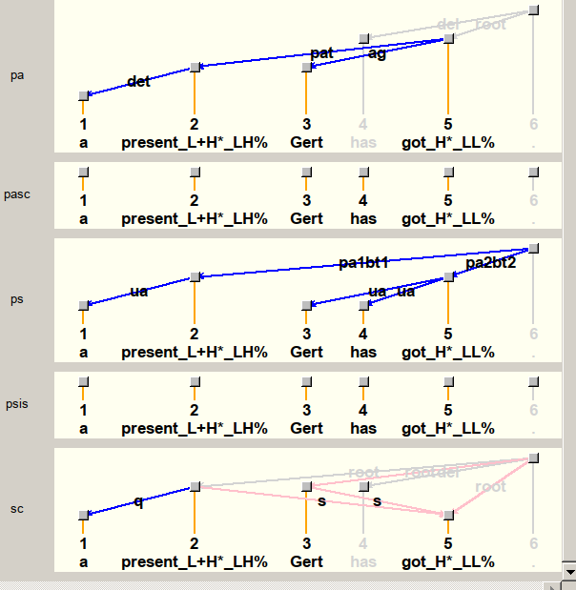
XDG Example Analysis
Predicate- Argument
Structure
Syntactic
Dependencies
Quantifier
Scope (ambiguity)
Topological
Fields

Slide 14
Achievements Around XDG
Implementation in Mozart-Oz (including a Principle Compiler, CLLS integration, XTAG integration etc.)
First steps towards statistical search and grammar generation (nowadays you would call that Neuro-Symbolic AI) (Dienes/Koller/Kuhlmann 2003, Korthals 2003, Bojar 2004, Narendranath 2004 - “SXDG“)
NP-hardness proof (Debusmann/Kuhlmann 2007)
Already used Gecode (Christian Schulte, Guido Tack 2006) for Constraint Solving instead of Mozart-Oz

Slide 15
The Problems
With XDG, you can not only parse natural language utterances (and get a semantic representation, e.g. in predicate logic)...
... but also generate natural language utterances from a semantic representation.
Was this already some kind of GenAI? Well...
...no. Scalability problems (at least two):
Problem 1: The underlying grammars needed to be handcrafted by linguists => Extremely time-intensive and expensive, actually unrealistic for large coverage
Problem 2: The constraint parser was too slow for longer utterances or entire text paragraphs (NP-hardness...) – at least several seconds per longer sentence

Slide 16
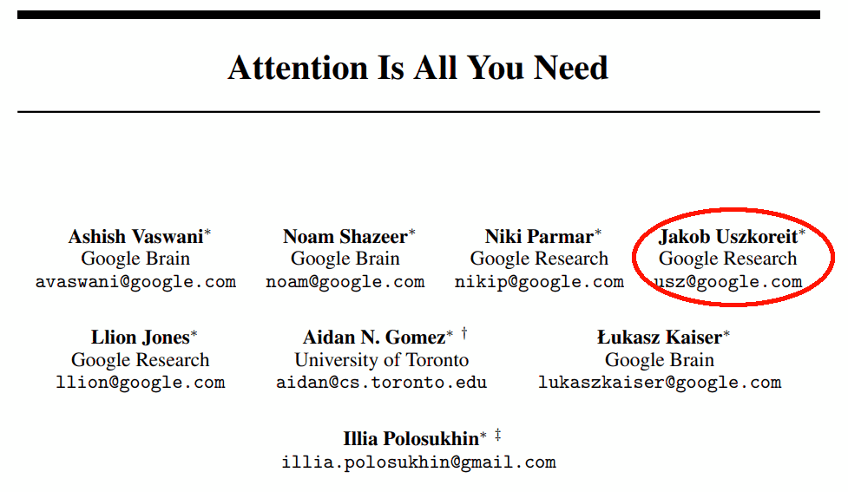
The Age of Large Language Models
So why could XDG still be relevant today, in the age of LLMs?
LLMs are cool – and did you know – Hans Uszkoreit‘s son Jakob co-authored the breakthrough paper behind the underlying Transformer models...
But:
No reliable way to get from an utterance to a semantic representation
No reliable way to get from a semantic representation to an utterance
IMHO, LLMs are uncontrollable black boxes...
...capturing only one part of human intelligence: System 1 (Kahnemann, 2002)

Slide 17
XDG and the Rise of Neuro-Symbolic AI
A number of (IMHO) hacks are being applied to fix LLMs:
RAG (Retrieval Augmented Generation)
Agentic AI (modularization, a bit like microservices)
...
But there is also research on blending symbolic AI with the new purely ML-based AI, e.g. work by Subbarao Kambhampati, Evgeny Skvortsov...
Let‘s go back to XDG. With LLMs, we could mitigate its first scalability problem: We could use LLMs to create XDG grammars (semi-)automatically
First approaches exist, e.g. for LFG, another grammar formalism: (Spencer/Kongborrirak, 2024)

Slide 18
XDG and Quantum Computing
To mitigate the second scalability problem of XDG (performance), we could look at Quantum Computing
New Quantum and Quantum Annealing Computers are getting better and better error correction, e.g. Google‘s Willow – with breathtaking results at least on benchmarks
So – how about implementing the constraint solver on a Quantum Computer? First attempts in this direction are already being undertaken, e.g. (Codognet, 2024)

Slide 19
2. Down-to-Earth Software Engineering

Slide 20
2. Down-to-Earth Software Engineering
In 2007, I had to “go down“ from Academia and “AI“ to down-to-earth software engineering – why?
Hard to find a permanent position in academia...
Not an abundance of “AI jobs“ in the industry as well at that time (still AI winter)
So I went to SAP (2008-2019) and Bosch (2019-2022) to work on Software Logistics (Java), the new HANA database (C++), UI Translation tooling (Java, ABAP, JavaScript), Cloud Architecture...
...and midway through this, I had a revelation...

Slide 21
Scala
In 2014, I discovered the Scala programming language
Scala? Back in WS 2005/6, I had co-organized a seminar on “Advanced Functional Programming“ with Christian Lindig, Andreas Rossberg, Gert and Jan Schwinghammer – where we mentioned Scala already
Scala was started in Jan 2004, by Martin Odersky, a colleague of Gert‘s...

Slide 22

From Scala to Kafka
Especially two very popular Big Data analytics tools were written in Scala:
Spark (now backed mainly by Databricks)
Kafka (now backed mainly by Confluent)
I liked Kafka especially, and fell into the rabbit hole of the data streaming world..
...where I am still in, earning money for the family, presenting at and organizing conferences, writing a book...
Maybe, I wouldn‘t have got there if it was not for the connection with Gert and the inspirational environment at his PS-Lab :-)

Slide 23
What is Kafka
Data streaming platform to synchronize systems, databases, microservices etc. in (near-)real-time
Developed at LinkedIn (2009+)
Essentially a message queue with (possibly) infinite persistent storage
Backbone for virtually all bigger apps (LinkedIn, Uber, Netflix...), used a lot in banking, stock exchanges, retailers, postal services...
AI: Kafka used for RAG database updates and Agentic AI inter-communication

Slide 24
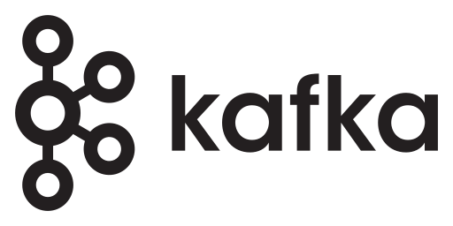
Kafka Illustration
Target System 1
Source System (e.g. database)
Target System 2
Target System 3
...
Target System N

Slide 25
Stream Processing
Even more interesting than data streaming itself is stream processing
Idea: Incremental processing of data “in motion“, “when it arrives“
In a database: Entire data sets have to be traversed for each operation (e.g. for doing a “Join“ operation)
Stream processing: Only the changes (“deltas“) need to be processed
Especially important for large quantities of data, e.g. banking and retail (fraud detection etc.) and if there are real-time requirements

Slide 26
Consistency
At the beginning of 2023, I discovered the next exciting topic
Classical stream processing (up to 2020) only provides very basic consistency guarantees (“eventual consistency“)
That can easily lead to inconsistent data – and this approach is used a lot in banking and retail (!)

Slide 27
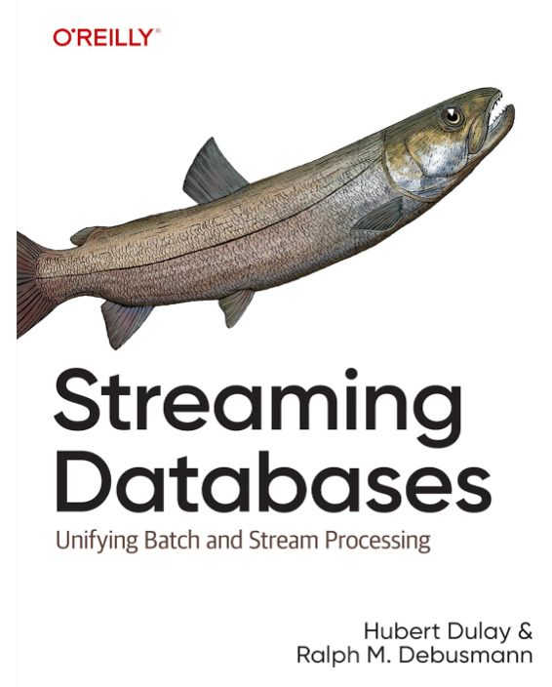
Streaming Databases
Newer, less ad-hoc and more mathematically sound approaches based on Differential Dataflow (McSherry et al. 2013) and DBSP (Budiu et al. 2023)
Differential Dataflow was originally built for AI as well – as an engine for running Datalog (a Prolog subset)
Offer full consistency as in a database => Streaming Databases
O‘Reilly book: (Dulay/Debusmann, 2024)

Slide 28
3. Back to AI?

Slide 29
3. Back to AI?
Years before being the CTO of an AI startup in the BASF incubator (Forecasty.AI, 2022-2023), I discovered the topic of my heart
I was annoyedby the new AI hype already in 2016, so I thought: “What about focusing on Human Intelligence (HI) again?“
Started end of 2016 as in internal startup at SAP, gathered three seniors and four juniors to implement a prototype
This is how it works...

Slide 30
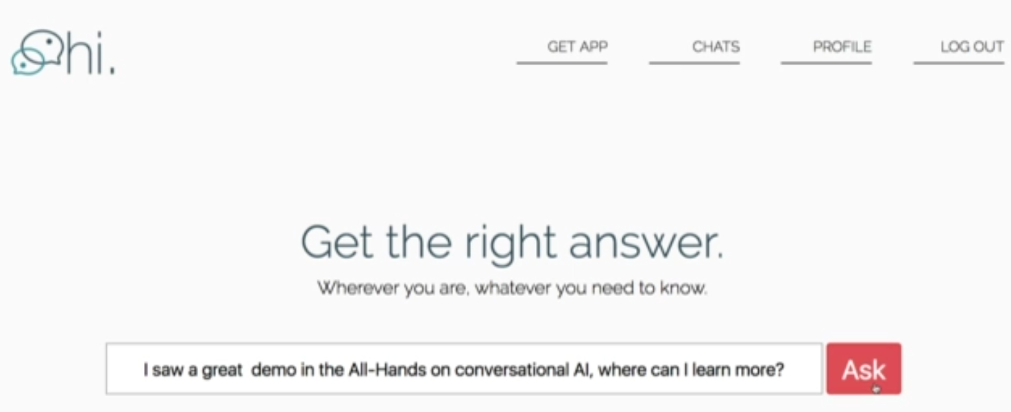
Human Intelligence (HI) – Step 1
Submit a search query/question just like in Google/ChatGPT...

Slide 31
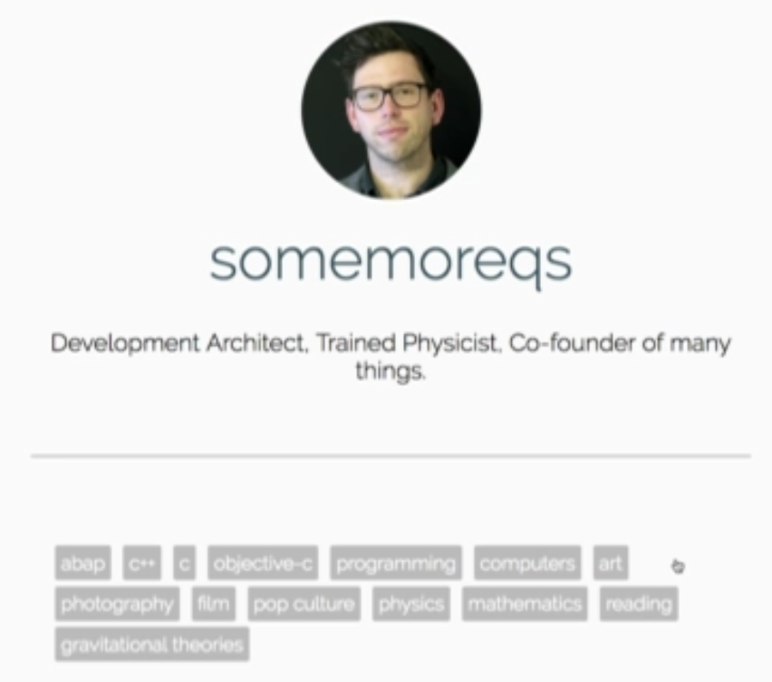
Human Intelligence (HI) – Step 2
We have a profile database of users where they tell us their skills using “hash tags“:...

Slide 32
Human Intelligence (HI) – Step 3
We do a matching based on word embeddings (Mikolov et al. 2013) of the query and the profile database
Pure Python coding, no fancy vector databases available at that time ;-)
Result: The best possible dialogue partner for the user who submitted the query to help answering the query/question

Slide 33
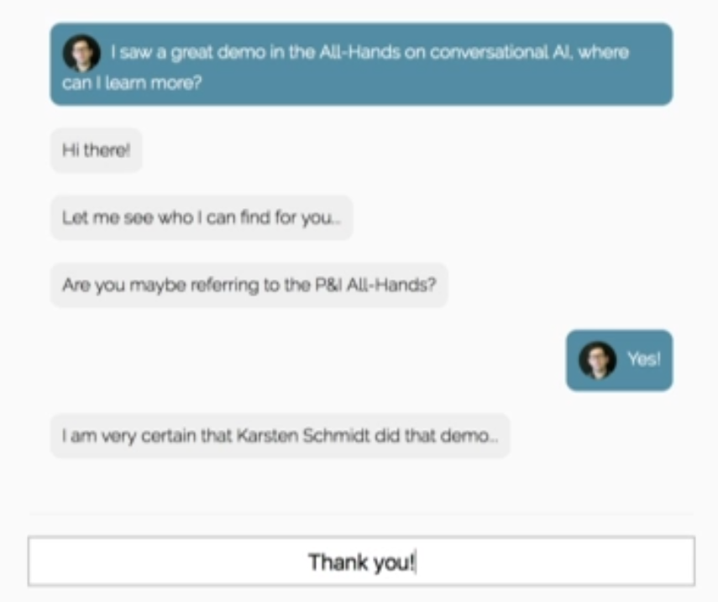
Human Intelligence (HI) – Step 4
After we‘ve found the best available dialogue partner, we throw the user who submitted the query into a chat with her/him:

Slide 34
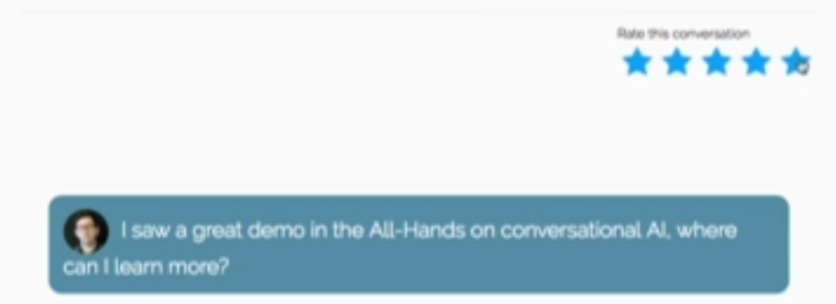
Human Intelligence (HI) – Step 5
After the chat, we ask for a rating and persist it with the chat...

Slide 35
So What Is HI?
Kind of an “online StackOverflow/Reddit/Quora“ – in (near-)real-time
Can be extended in all kinds of ways:
Corporate version (as we built it at SAP)
“Human App Store“ where lawyers, doctors etc. can receive money for their help
Hybrid search engine:
Human dialogue partners (HI)
LLM-based dialogue partners (AI)
What would people chose for what kind of query?
Feeds with the most interesting conversations
=> Could naturally be extended into a fully-fledged social network like Facebook, LinkedIn...
...and, in theory, could become bigger than all of them if done right (megalomaniac alert!)

Slide 36
What Happened to HI
In 2018, HI was too far away from SAP‘s core business and we didn‘t get any real funding
I wasn‘t daring enough to continue on my own
There was no really sustainable business model (now with OpenAI, Anthropic et al. needing ever more data for training their models, you would have one...e.g. Human Native AI)
HI fell asleep.

Slide 37
Why Hasn‘t Anybody Done This Yet?
During our research, we found a similar “human search engine“ that had already been built: Aardvark (Horowitz/Kamvar 2010)
Aardvark was acquired by Google for $50M in 2010... and shut down in 2011.
NB: At that time, smartphones were still new, there was no WhatsApp etc., and unlike now, not everybody was (virtually) always online...
Plus: It was still “AI winter“ – no word embeddings, no LLMs...

Slide 38
Please Build HI Now!
...so now could be the time. Please build something like HI now.
Now, In 2025, everybody is always online.
People would use the internet to help each other, not just to boast on Facebook or Instagram (and not get fact-checked), or get dumber by just watching TikTok videos.
People would be encouraged to learn to be able to answer more questions and boost their profile.
...and we would push forward Human Intelligence again, and use Artificial Intelligence for bringing humankind together.

